Slide 1






1ˢᵗ IEEE Uttar Pradesh Section Women in Engineering
International Conference on Electrical Electronics and Computer Engineering
Paper ID: 467
Title: AgriCastNet, A Unified Deep Forecasting Framework for Smart Greenhouse Microclimates.
Presenter Name: Syed. Tasneem Banu
Affiliation: Dept of CSE, Narasaraopeta Engineering College, JNTUK, Andhra Pradesh, India

Slide 2
Contents
Introduction and Brief Review
Methodology
Experimental Setup
Result and Discussion
Conclusion

Slide 3
INTRODUCTION & BRIEF REVIEW
Greenhouse farming enables controlled crop growth even under changing outdoor climates. Inside a greenhouse, factors like temperature, humidity, CO₂, sunlight, and water must stay balanced for healthy plant growth.
Existing deep learning models like LSTM and GRU predict trends well but often fail under sensor faults or in different climate zones.
To address this, we developed AgriCastNet, a framework designed for fault-tolerant and adaptive climate forecasting.
We evaluated five models — PLSTM, CNN + BiLSTM, XGBoost, TFT, and TCN — to compare performance. Among them, CNN + BiLSTM performed best, learning both spatial (CNN) and temporal (BiLSTM) features effectively.
Using real greenhouse data from Spain and Mexico, the system proved cross-zone adaptability and achieved 99.67% accuracy for reliable real-time predictions.

Slide 4
METHODOLOGY
Data Source & Preprocessing:
Collected real greenhouse datasets from Spain and Mexico, covering diverse climatic zones. Cleaned missing and inconsistent sensor values, applied Min–Max normalization, and reshaped data into 3D time-series sequences for model input.
Feature Engineering:
Derived Climatic Influence Indicators (CII) to quantify each sensor’s temporal importance. Engineered multi-sensor relationships (e.g., temperature–humidity–dew point) to improve fault resilience and adaptive learning.
Model Development:
Implemented and compared five deep learning models — PLSTM, CNN + BiLSTM, XGBoost, TFT, and TCN. Trained with Adam optimizer, 30 epochs, and 5-Fold Cross Validation for tuning and consistency.
Proposed Framework – AgriCastNet:
Integrated CII with a hybrid CNN + BiLSTM architecture to capture both spatial and temporal patterns. Achieved real-time, cross-zone greenhouse climate forecasting with enhanced fault tolerance and model stability.

Slide 5
EXPERIMENTAL SETUP
ENVIRONMENT CONFIGURATION: All experiments were executed in Google Colab with GPU acceleration. Development and testing were done using Python, leveraging libraries like TensorFlow, Keras, Scikit-learn, and XGBoost.
DATA SPLIT & VALIDATION: The dataset was divided into 80% training and 20% testing, with 5-Fold Cross Validation ensuring robust performance and preventing overfitting.
TRAINING PARAMETERS: Models were trained for 30 epochs, with batch sizes between 16–64, using the Adam optimizer and Bayesian optimization for learning rate tuning.
EVALUATION METRICS: Performance was assessed using Accuracy, R² Score, RMSE, and MAE. These metrics validated both predictive precision and generalization capability across all models.
COMPARATIVE FRAMEWORK: All five models — PLSTM, CNN + BiLSTM, XGBoost, TFT, and TCN — were trained under identical conditions to ensure fair and consistent comparison.

Slide 6
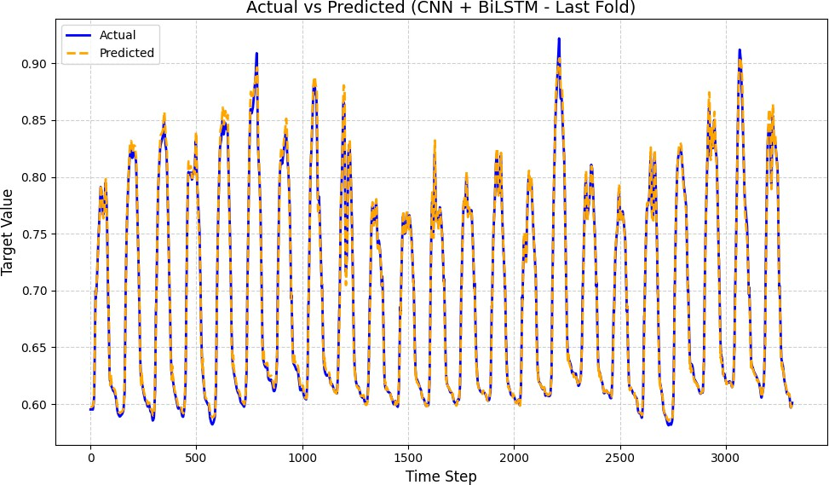
RESULTS & DISCUSSIONS
🔹 Model Comparison:
Five models — PLSTM, CNN + BiLSTM, XGBoost, TFT, and TCN — were trained under identical settings. The CNN + BiLSTM hybrid achieved the most accurate and stable performance, followed by XGBoost and TCN, proving the benefit of combining convolutional and recurrent layers.
🔹 Performance Metrics:
Accuracy: 99.67% | R²: 0.9967 | RMSE: 0.031 | MAE: 0.021
These results confirm high precision and low prediction error across all validation folds.
🔹 Key Insights:
The CNN + BiLSTM model achieved the highest accuracy (99.67%), proving that combining spatial and temporal learning significantly enhances greenhouse climate prediction accuracy.
The models maintained strong cross-zone generalization between Spain and Mexico, demonstrating their reliability and adaptability to diverse climatic conditions.
🔹 Interpretation:
AgriCastNet demonstrated superior performance over all baseline models, delivering a robust, adaptive, and high-accuracy solution for real-time greenhouse climate forecasting in smart agriculture.
fig: Actual vs Predicted graph

Slide 7
CONCLUSION
AgriCastNet provides a unified deep learning framework for accurate and adaptive greenhouse climate forecasting.
The integration of Climatic Influence Indicators (CII) enhances fault tolerance and maintains accuracy even under sensor failures.
The CNN + BiLSTM hybrid model achieved the highest accuracy (99.67%), effectively capturing both spatial and temporal dependencies.
The framework demonstrated strong cross-zone generalization, performing consistently on data from Spain and Mexico.
Overall, AgriCastNet offers a scalable, reliable, and real-time solution for smart greenhouse management and sustainable agriculture.

